Slide 1

Capstone Project Airbnb Booking Analysis
By-Akash Jaiswal
jaiswalaj292@gmail.com

Slide 2
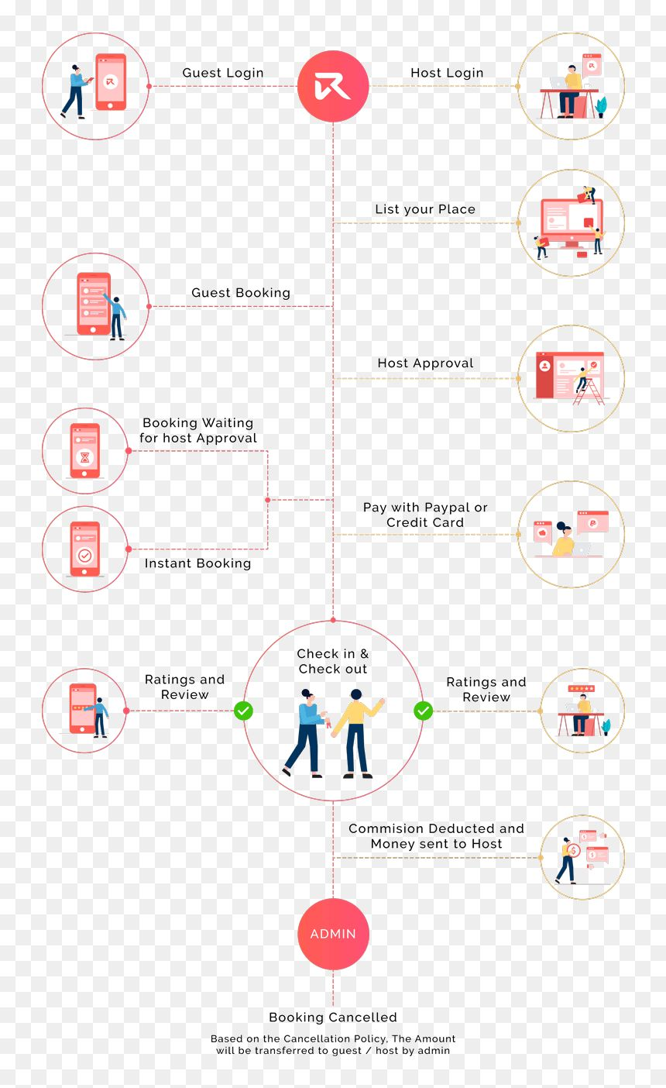
About the Dataset - Airbnb Bookings
+ This Airbnb dataset contains 49,000 observations from New York, with 16 columns of data.
+The Data includes both categorical and numeric values, providing a diverse range of information about the listings.
+ This dataset may be useful for analyzing trends and patterns in the Airbnb market in New York and also for gaining insights into the preferences and behaviour of Airbnb users in the area.
+ This dataset contains information about Airbnb bookings in New York City in 2019. By analyzing this data, you may be able to understand the trends and patterns of Airbnb use in NYC.

Slide 3
Understand The Given Variables
Listing id:- This is a unique identifier for each listing in the dataset.
Listing name: This is the name or title of the listing, as it appears on the Airbnb website.
Host_id:- This is a unique identifier for each host in the dataset.
Host_name: This is the host’s name as it appears on the Airbnb website.
Neighbourhood_group:- This is a grouping of neighbourhoods in New York City, such as Manhattan or Brooklyn.
Neighbourhood:- This is the specific neighbourhood in which the listing is located.
Latitude:- This is the geographic latitude of the listing.
Longitude:- This is the geographic longitude of the listing.
Room_type: This is the type of room or property being offered, such as an entire home, private room, shared room.
Price: This is the nightly price for the listing, in US dollars.
Minimum_nights: This is the minimum number of nights that a guest must stay at the listing.
Total_reviews: This is the total number of reviews that the listing has received.
Reviews_per_month: This is the average number of reviews that the listing receives per month.
Host_listings_count:- This is the total number of listings that the host has on Airbnb.
Availability_365:- This is the number of days in the next 365 days that the listing is available for booking.

